Slide 1

7th Grade Math
Unit 12, Lesson 2 Finding Surface Area of Right Circular Cylinders Volume 2, pg. 204

Slide 2


Benchmark
MA.7.GR.2.1
Given a mathematical or real-world context, find the surface area of a right circular cylinder using the figure’s net.
MA.7.GR.2.2
Solve real-world problems involving surface area of right circular cylinders.
volume 2, pg. 204

Slide 3
Integrated Mathematical Thinking and Reasoning Standards
MA.K12.MTR.1.1 Actively participate in effortful learning both individually and collectively.
MA.K12.MTR.2.1 Demonstrate understanding by representing problems in multiple ways.
MA.K12.MTR.3.1 Complete tasks with mathematical fluency.
MA.K12.MTR.4.1 Engage in discussions that reflect on the mathematical thinking of self and others.
MA.K12.MTR.5.1 Use patterns and structure to help understand and connect mathematical concepts.
volume 2, pg. 204

Slide 4

Learning Targets
I can draw the net of a right circular cylinder.
I can find the surface area of a right circular cylinder.
volume 2, pg. 204

Slide 5

Warm-Up
volume 2, pg. 204

Slide 6
12.2.1 Warm-Up: Manufacturing Engineer
Joenel Johnson, a senior manufacturing engineer, mentions that one of his responsibilities is to interpret and explain, in layman’s terms (common language), the drawings of the design engineers to the technicians he works with.
Describe a time when you had to interpret for yourself or explain a math problem to a partner. What did you do to ensure that you or your partner understood the problem?
volume 2, pg. 204

Slide 7

Guided Instruction
volume 2, pg. 205

Slide 8
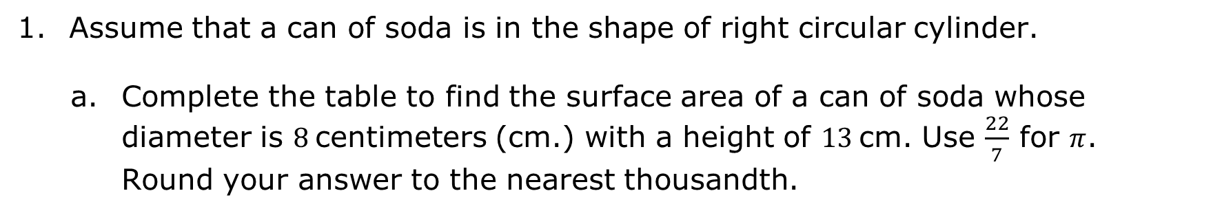
12.2.2 Guided Instruction: Finding the Surface Area of Right Circular Cylinder
Assume that a can of soda is in the shape of right circular cylinder.
Complete the table to find the surface area of a can of soda whose diameter is $8$centimeters (cm.) with a height of $13$cm. Use $\frac{22}{7}$ for $π$. Round your answer to the nearest thousandth.
Draw a net and label its dimensions. (Include units.)
Determine the area of one circular base. (Include units.)
volume 2, pg. 205

Slide 9
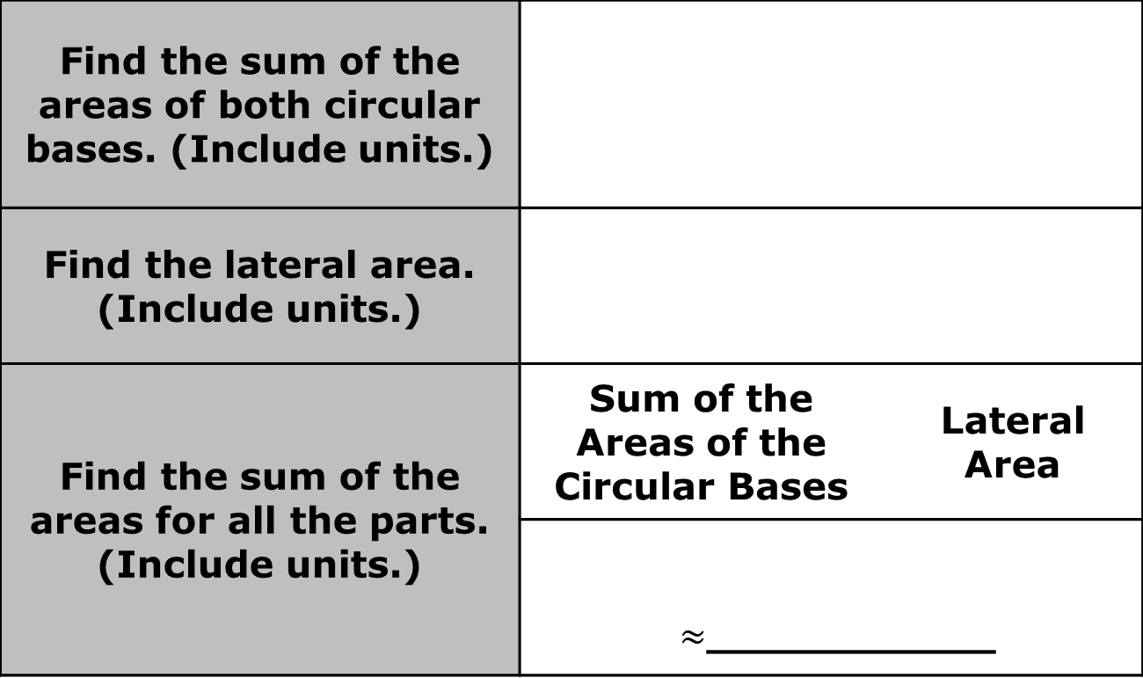
Find the sum of the areas of both circular bases. (Include units.)
Find the lateral area. (Include units.)
Find the sum of the areas for all the parts. (Include units.) | Sum of the Areas of the Circular Bases | Lateral Area
 | $≈$___________
volume 2, pg. 205

Slide 10
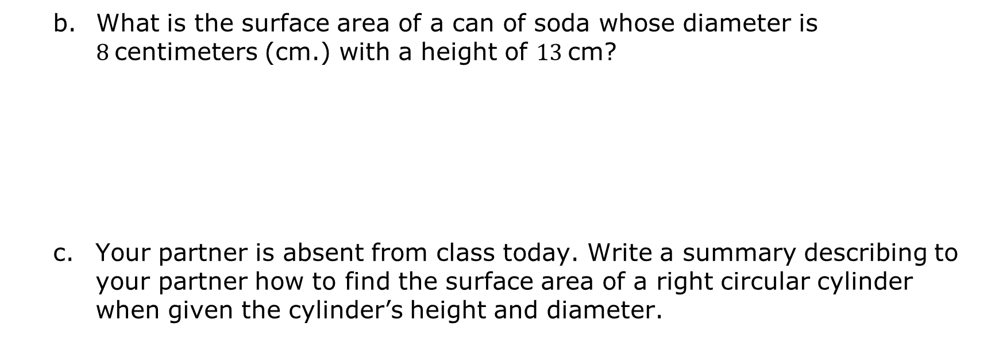
What is the surface area of a can of soda whose diameter is $8$centimeters (cm.) with a height of $13$cm?
Your partner is absent from class today. Write a summary describing to your partner how to find the surface area of a right circular cylinder when given the cylinder’s height and diameter.
volume 2, pg. 205

Slide 11
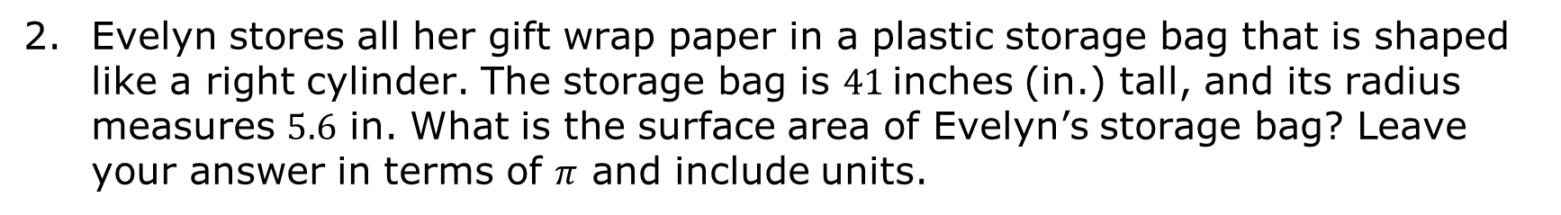
Evelyn stores all her gift wrap paper in a plastic storage bag that is shaped like a right cylinder. The storage bag is $41$inches (in.) tall, and its radius measures $5.6$ in. What is the surface area of Evelyn’s storage bag? Leave your answer in terms of $π$ and include units.
volume 2, pg. 205

Slide 12
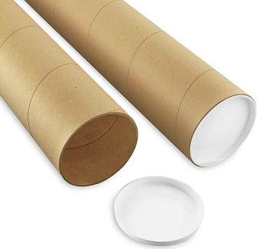



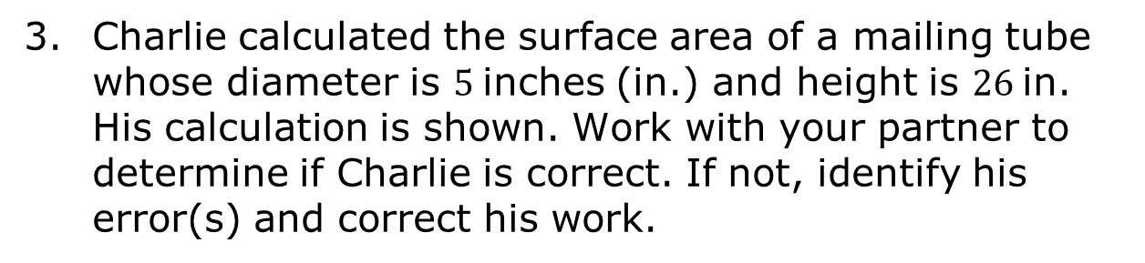

Charlie calculated the surface area of a mailing tube whose diameter is $5$inches (in.) and height is $26$in. His calculation is shown. Work with your partner to determine if Charlie is correct. If not, identify his error(s) and correct his work.
$$\left(π∙5^{2}\right)+2∙π∙5∙26$$
$$25π+10π∙26$$
$$25π+260π$$
$$285π$$
volume 2, pg. 206

Slide 13

Guided Practice
volume 2, pg. 206

Slide 14

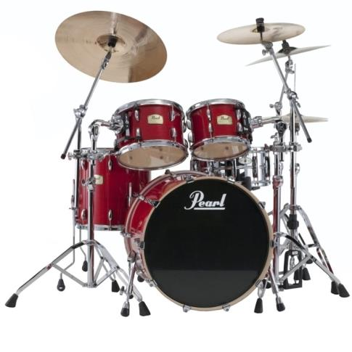
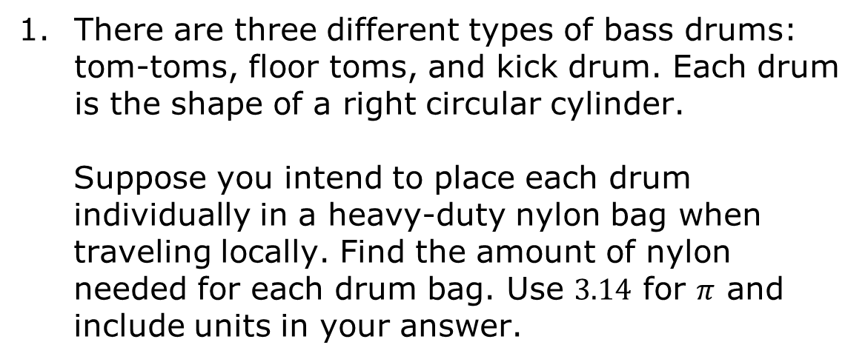
12.2.3 Guided Practice: Finding Surface Areas of Right Circular Cylinders
There are three different types of bass drums: tom-toms, floor toms, and kick drum. Each drum is the shape of a right circular cylinder.
Suppose you intend to place each drum individually in a heavy-duty nylon bag when traveling locally. Find the amount of nylon needed for each drum bag. Use $3.14$ for $π$ and include units in your answer.
Tom-Tom
Floor Tom
Kick Drum
volume 2, pg. 206

Slide 15
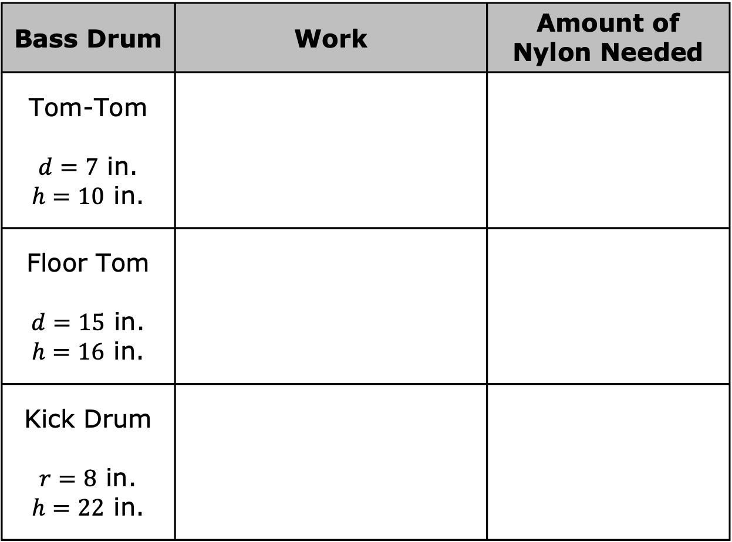
Bass Drum | Work | Amount of Nylon Needed
Tom-Tom $d=7$ in. $h=10$ in.
Floor Tom $d=15$ in. $h=16$ in.
Kick Drum $r=8$ in. $h=22$ in.
volume 2, pg. 206

Slide 16

Your Turn
volume 2, pg. 207

Slide 17
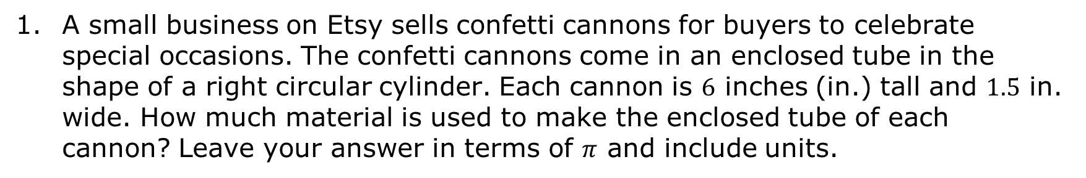
12.2.4 Your Turn!
A small business on Etsy sells confetti cannons for buyers to celebrate special occasions. The confetti cannons come in an enclosed tube in the shape of a right circular cylinder. Each cannon is $6$ inches (in.) tall and $1.5$ in. wide. How much material is used to make the enclosed tube of each cannon? Leave your answer in terms of $π$ and include units.
volume 2, pg. 207

Slide 18

Wrap-Up
volume 2, pg. 207

Slide 19


12.2.5 Wrap-Up: Reflection
Take a SELFIE by checking the box that best matches what you did today.
Showed my work
Explained my answers
Lots of math vocabulary used
Found multiples solutions
I persevered through the problem
Eliminated careless errors
volume 2, pg. 207

